Slide 1
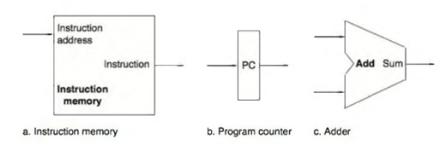
Elements of Datapath for the fetch and increment
The first element we need: a memory unit to store the instructions of a program and supply instructions given an address.
The program counter (PC), which is a register that holds the address of the current instruction.
Lastly, we will need an adder to increment the PC to the address of the next instruction. This simple adder can be built from the big ALU performing simple changes on it.

Slide 2
The Datapath for the fetch and increment
Figure below shows how to combine the three elements to form a datapath that
that fetches instructions
increments the PC
to obtain the address of the next sequential instruction.
The fetched instruction is used by other parts of the datapath

Slide 3
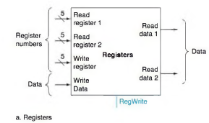
The Datapath for R-type instructions. Registers.
The register file contains all the registers and has two read ports and one write port.
The register file always outputs the contents of the registers corresponding to the Read register inputs on the outputs; no other control inputs are needed.
In contrast, a register write must be explicitly indicated by asserting the write control signal.
The inputs carrying the register number to the register file are all 5 bits wide, whereas the lines carrying data values are 32 bits wide.

Slide 4
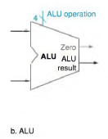
The Datapath for R-type instructions. ALU.
Two operands are supplied to the input of ALU and the result is taken from the output.
There could be many types of results depending on the operation done by ALU (And, Or, Add, Subtract, Set on Less Than, NOR).
The operation to be performed by the ALU is controlled with the ALU operation signal, which will be 4 bits wide.
We will use the Zero detection output of the ALU shortly to implement branches.

Slide 5
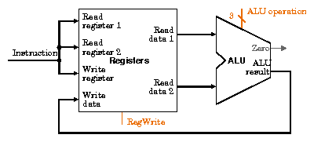
The datapath for R-type instructions.
They all read two registers,
perform an ALU operation on the contents of the registers,
and write the result to a register.

Slide 6
Load and Store instructions. Data Memory. Sign Extension unit.
The two units needed to implement loads and stores, in addition to the register file and ALU , are the data memory unit and the sign extension unit.
The memory unit is a state element with inputs for the address and the write data, and a single output for the read result.
There are separate read and write controls, although only one of these may be asserted on any given clock.
The sign extension unit has a 16-bit input that is sign-extended into a 32-bit result appearing on the output.

Slide 7
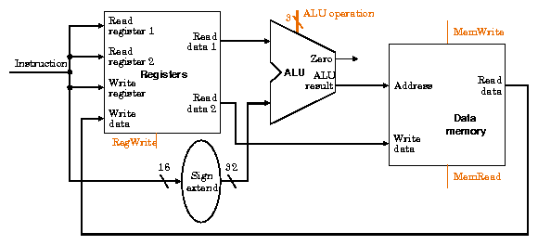
The Datapath for Load and Store The Address
These instructions compute a memory address by adding the base register to the 16-bit signed offset field contained in the instruction.
then a read or write from memory

Slide 8
The Datapath for Load and Store The Data
If the instruction is a store, the value to be stored must also be read from the register file.
If the instruction is a load, the value read from memory must be written into the register file in the specified register.

Slide 9
The Datapath for Branch
The beq instruction has three operands
beq $t1 ,$t2 ,offset
two registers that are compared for equality,
and a 16-bit offset used to compute the branch target address relative to the branch instruction address.
The branch datapath must do three operations:
compute the branch target address
compare the register contents.
jump or continue by PC+4

Slide 10
The Datapath for Branch target address calculation
To implement this instruction, we must compute the branch target address by adding the sign-extended offset field of the instruction to the PC.
The base for the branch address calculation is the address of the instruction following the branch.
Since we compute PC + 4 in the instruction fetch datapath, it is easy to use this value as the base for computing the branch target address.
The offset field is shifted left 2 bits so that it is a word offset;

Slide 11
The Datapath for Branch Comparison
We must determine whether the next instruction is the instruction that follows sequentially or the instruction at the branch target address.
ALU compares both registers and gives us the result
either Equal
or Not Equal

Slide 12
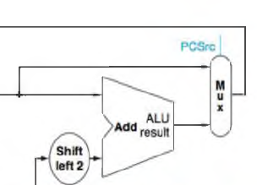
The Datapath for Branch Branch Taking
When the condition is true (i.e., the operands are equal), the branch target address becomes the new PC
we say that the branch is taken. PCSrc =0
If the operands are not equal, the incremented PC should replace the current PC (just as for any other normal instruction); PCSrc =1
we say that the branch is not taken.

